Slide 1
Changes Over Time and Disparities in Kentucky’s Lung, Breast and Colorectal Cancer Burden
Presented by:
Jaclyn K. McDowell, DrPH
Epidemiologist
Kentucky Cancer Registry
Thomas C. Tucker, PhD, MPH
Associate Director
Kentucky Cancer Registry
Kentucky Cancer Consortium Webinar
May 28, 2020
Notes:
Cer Center

Slide 2
Topic to be Covered
Characteristics of the Kentucky population
The major types of cancer for which there are evidence-based interventions
Trends and disparities in lung cancer incidence and mortality
Discussion (How to address lung cancer disparities)
Trends and disparities in breast cancer incidence and mortality
Discussion (How to address breast cancer disparities)
Trends and disparities in colorectal cancer incidence and mortality
Discussion (How to address colorectal cancer disparities)

Slide 3
Characteristics of the Kentucky Population
Demographic Characteristics | Kentucky | Appalachian KY | United States
Population* | 4,467,673 | 1,192,868 | 328,239,523
% White* | 87.6% | 94.5% | 76.5%
% African American | 8.4% | 1.9% | 13.4%
% All Other Races* | 4.0% | 3.6% | 10.1%
% Below Poverty* | 16.9% | 25.6% | 11.8%
% High School Degree** | 85.7% | 77.8% | 87.7%
% Bachelor’s Degree** | 23.6% | 14.7% | 31.5%
% Living in Rural Areas* | 41.0% | 85.6% | 18.3%
# of New Primary Cancers*** | 30,137 | 8,681 | NA
* U.S. Census QuickFacts 2019, **U.S. Census QuickFacts 2014-2018, *** Kentucky Cancer Registry 2017

Slide 6
Lung Cancer Incidence

Slide 7
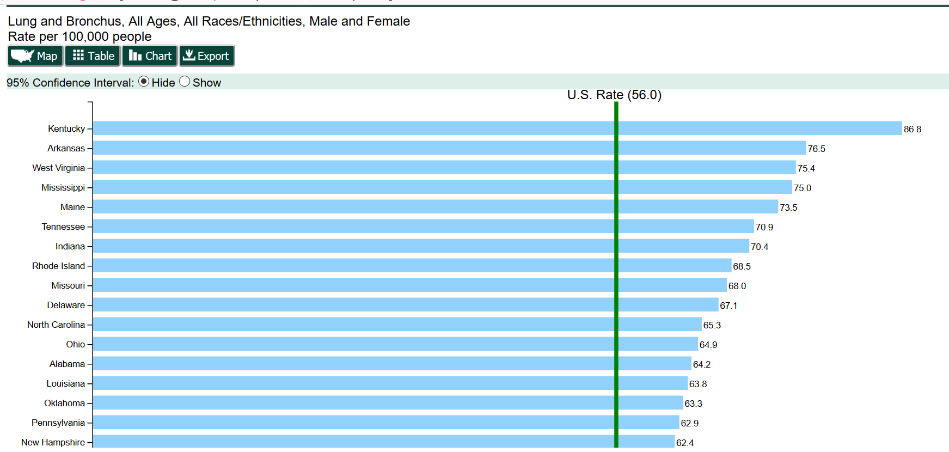
(Incidence 2012-2016)
Source: CDC USCS Website Accessed, May 21, 2020

Slide 8
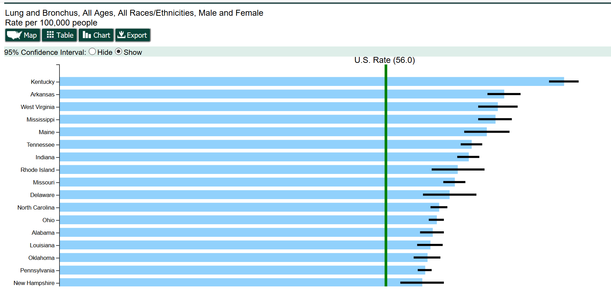
(Incidence 2012-2016)
Source: CDC USCS Website Accessed, May 21, 2020

Slide 11
R² = 0.6407

Slide 15
Lung Cancer Mortality

Slide 17
Lung Cancer Discussion Questions
How can we address the increasing lung cancer incidence rate among women in Appalachia?
How can we reduce the disparities in lung cancer incidence and mortality between Appalachian males and non-Appalachian males?
How can we further increase low dose computed tomography screening for at risk lung cancer patients to continue to reduce the lung cancer mortality rate in Kentucky?
Why has the lung cancer incidence rate among African Americans declined so rapidly?

Slide 18
Breast Cancer Incidence

Slide 19
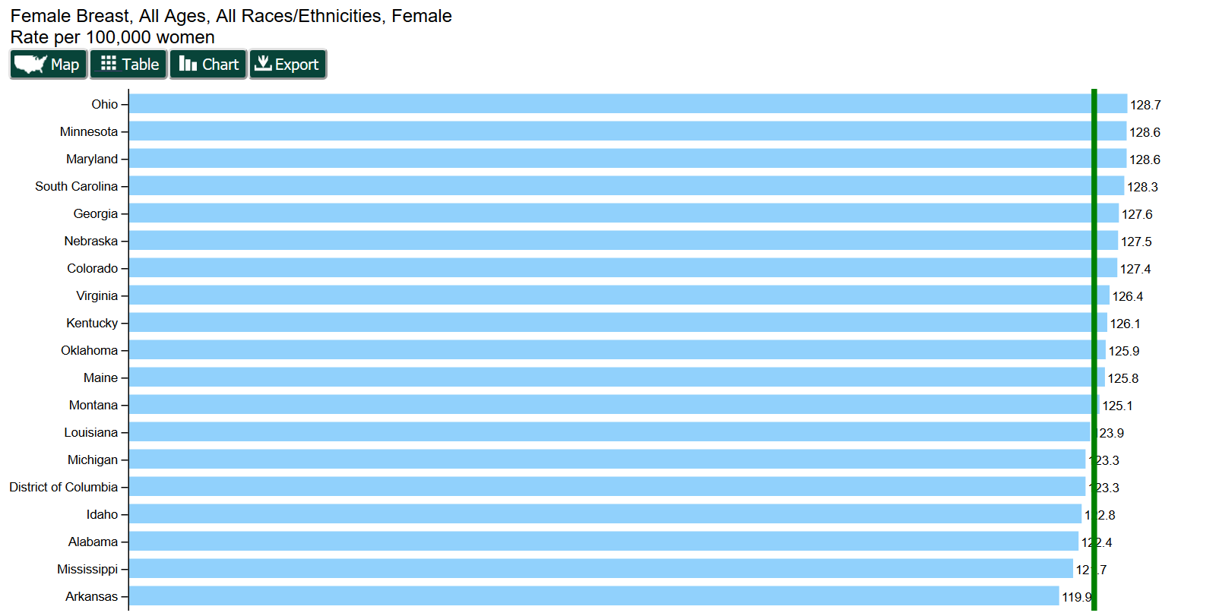
(Incidence 2012-2016)
U.S. Rate (124.2)
25th
Source: CDC USCS Website Accessed, May 21, 2020

Slide 25
Breast Cancer Mortality

Slide 29
Breast Cancer Discussion Questions
How can we address issues of health equity and reduce the breast cancer mortality rate among women in Appalachian Kentucky through increased screening?
How can we address issues of health equity and further reduce the breast cancer mortality rate among African American women in Kentucky who are at greater risk for triple negative breast cancer?
Why has the Kentucky breast cancer mortality rate remained flat in recent years?

Slide 30
Colorectal Cancer Incidence

Slide 31
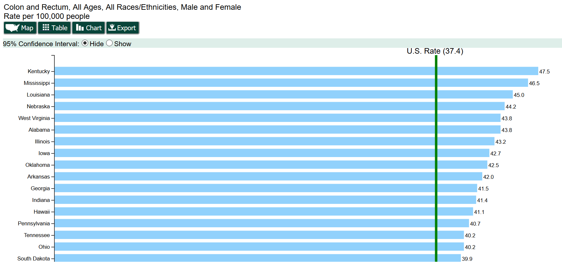
(Incidence 2012-2016)
Source: CDC USCS Website Accessed, May 21, 2020

Slide 32
49th
23rd
17th
Source: http://cdc.gov/brfss, Accessed October 2019
Notes:
In 2001 it was note that Kentucky had the highest colorectal cancer or CRC incidence rate compared to all other U.S. states. It was also noted that Kentucky was ranked 49th (second to the lowest) in colorectal cancer screening compared to all other states with just over one third (34.7%) of the age eligible population ever having a colonoscopy or a sigmoidoscopy. An index of the colorectal cancer burden was constructed by the Kentucky Cancer Registry and presented to both the statewide Cancer Consortium and to each of the 15 District Cancer Councils. The Cancer Consortium used these data to successfully advocated for a state law requiring health insurance companies in Kentucky to make screening colonoscopy a covered service for their age eligible policy holders and All 15 of the District Cancer Councils implemented evidence-based culturally sensitive cancer control intervention programs aimed at increasing colorectal cancer screening. Two of the key interventions were using lay health navigators to reduce cultural barriers and using academic detailing to convince primary care physicians to not just recommend screening, but to also schedule the colonoscopy for their age eligible patients. Following the implementation of this intensive statewide initiative in 2002, (Click) the colorectal cancer screening rate rose form (Click) just over one third of the age eligible population (Click) to nearly two thirds in just 7 years and the CRC screening rate (Click) continues to raise. Research has consistently shown that increased CRC screening reduces both the colorectal cancer incidence and mortality rates.

Slide 37
Colorectal Cancer Mortality

Slide 42
Colorectal Cancer Discussion Questions
How can we address issues of health equity and address the clear disparities in colorectal cancer among people living in Appalachian Kentucky?
How can we address issues of health equity and continue to reduce both the colorectal cancer incidence and mortality rates among African Americans in Kentucky?
Why has the colorectal cancer mortality rate in Kentucky remained flat for the past six recent years?

Slide 43
Thank you for all of your efforts to reduce the burden of cancer in Kentucky
Contact Information
Jaclyn K. McDowell, DrPH
Epidemiologist
Kentucky Cancer Registry
Jaclyn.mcdowell@uky.edu
Thomas C. Tucker, PhD, MPH
Associate Director
Kentucky Cancer Registry
thomas.tucker@uky.edu

